Slide 1
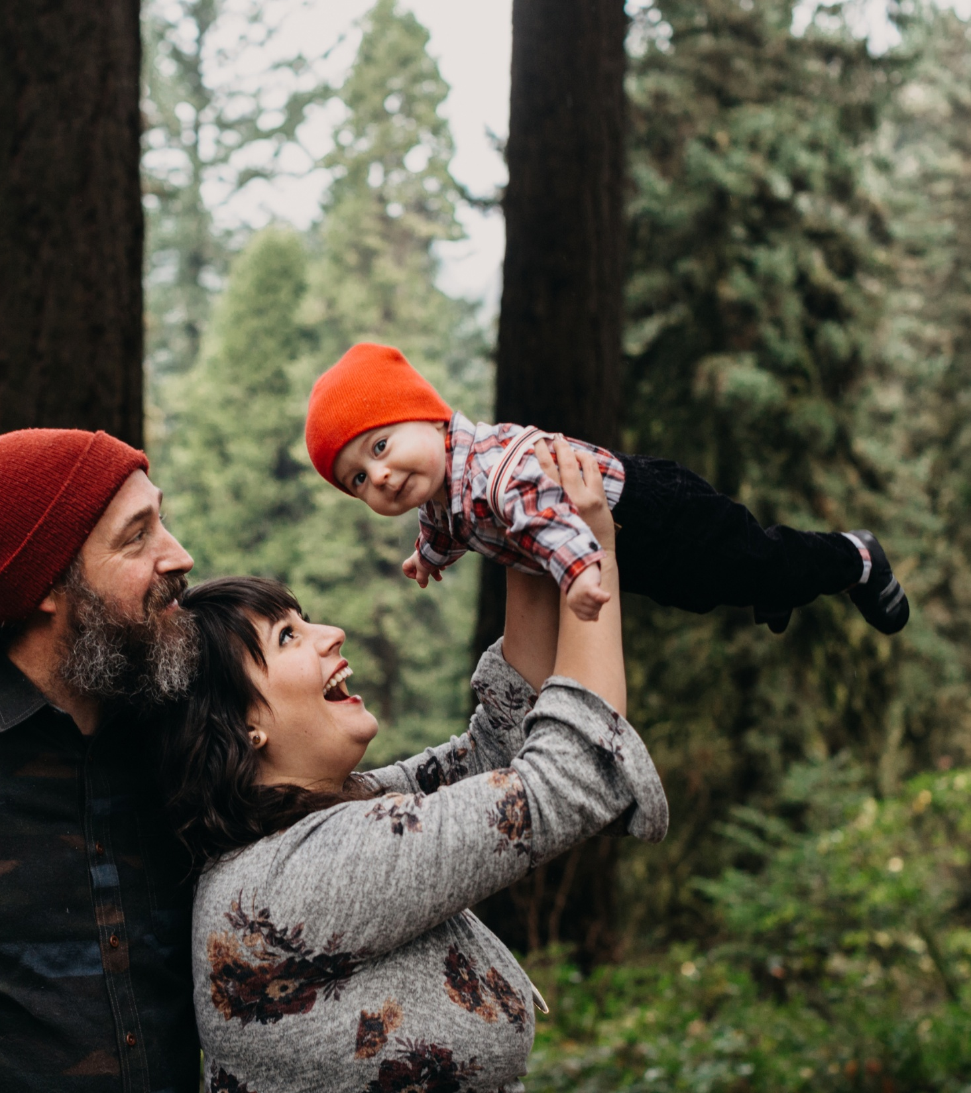

Nature and Early Childhood
2026 Parent Polling Results

Slide 2
TRF | Parent Polling | 2026
Methodology
Savanta interviewed a total of 1,009 parents to children aged 0-5 years old (18+) in the UK, between 16 September to 30 September 2026.
The 5-minute-long survey was conducted online with respondents drawn from Savanta’s research panel.
Quotas were used during fieldwork to ensure a representative sample of parents in the UK by age, gender and region.
The final parent survey data was weighted to be nationally representative of parents across the UK by age, gender and region.

Slide 3
TRF | Parent Polling | 2026
Many parents say nature is already a regular part of young children’s lives
ANALYSIS
Nature time is a regular part of life for most families: 75% say their baby or child spends time in nature at least three to four times a week, including 33% every day.
Differences across demographic groups are relatively limited, although daily nature time is somewhat higher among women than men (38% vs 29%).
NET: THREE TO FOUR TIMES A WEEK OR MORE
75%
Sample size: n = 1,009 | Base = All respondents | Q1 = "How often, on average, does your baby or child spend time in nature, including when in a childcare setting or at school?” (Single choice)

Slide 4
TRF | Parent Polling | 2026
However, many parents would like their child to spend more time in nature, both at home and in childcare or education
ANALYSIS
Younger parents are less likely to want more time in nature for their child overall. Half of 18–24s say they would like this (50%), compared with 67% of 25–34s and 68% of 45–54s, while 44% (18–24s) say the current amount is about right.
NET: MORE TIME
62%
56%
ANALYSIS
A similar pattern is seen for childcare or education. 44% of 18–24s would like their child to spend more time in nature in these settings, compared with 61% of 25–34s and 59% of 45–54s. Women are also more likely than men to say the current amount is about right (40% vs 34%).
NET: MORE TIME
Sample size: n = 1,009 | Base = All respondents | Q4 = "Thinking about your baby or child, would you like them to spend more, less or about the same amount of time in nature as they do now?” (Single choice) | Q5 = "Would you like your baby or child to spend more, less or about the same time in nature as part of their childcare (e.g., nursery or childminder) or education?” (Single choice)

Slide 5
TRF | Parent Polling | 2026
Parents strongly endorse both the benefits of nature and its place in family life
ANALYSIS
Women are more likely than men to agree that spending time in nature helps their child’s wellbeing and development (85% vs 82%), while agreement is lower among 18–24s (76%) than among 35–44s (87%).
NET: AGREE
10%
NET: DISAGREE
Sample size: n = 1,009 | Base = All respondents | Q10 = "To what extent do you agree or disagree with the following statements?” (Single choice)

Slide 6


Tom Shelley
Abby Tucker
Associate Director
Senior Consultant
thomas.shelley@savanta.com
abby.tucker@savanta.com

